Slide 1
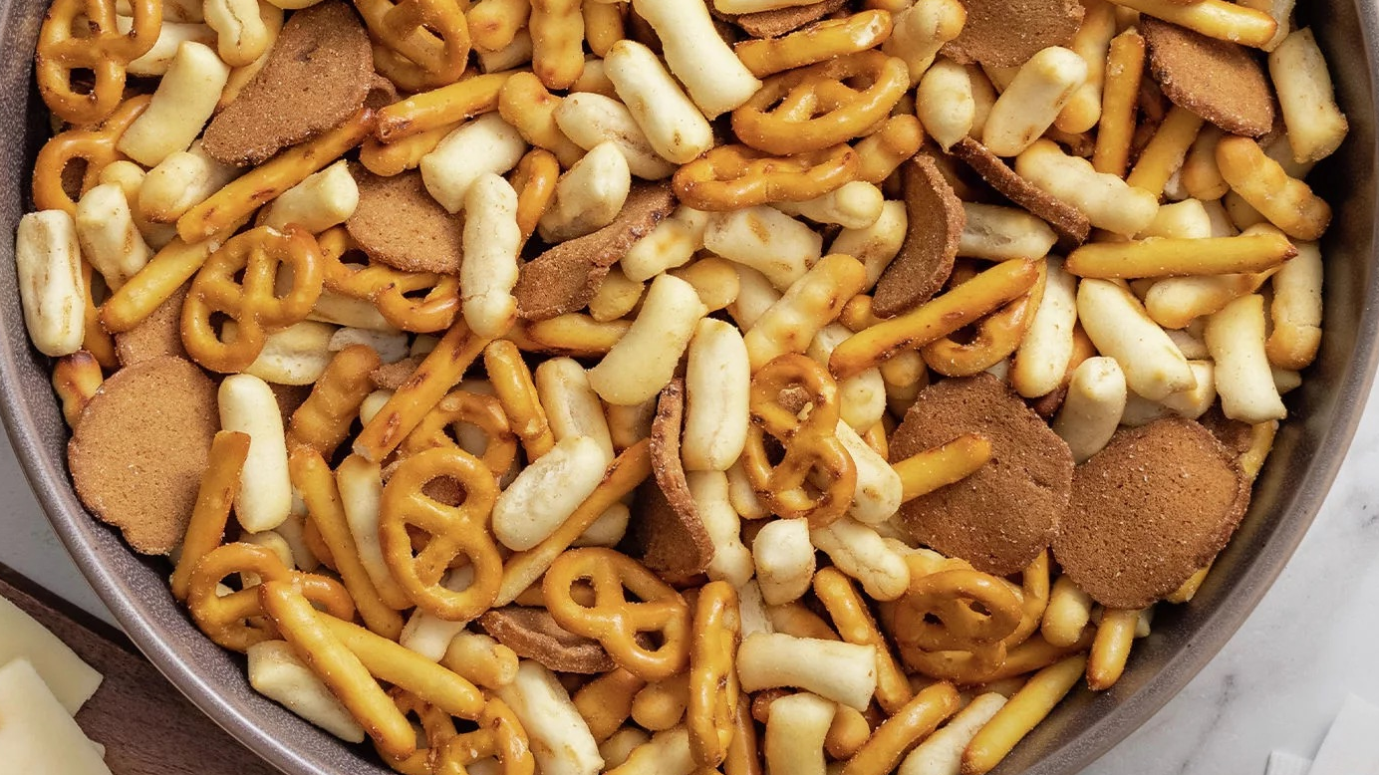



Gardetto’s New Balance Snack Mix
ALIENATION IHUT
June 2023
Made for:

Slide 2
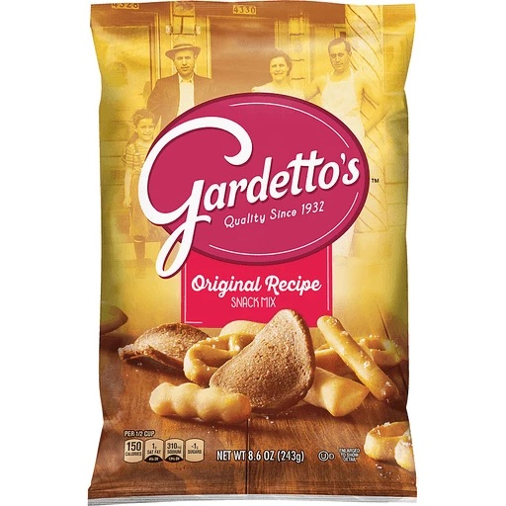
Alienation IHUT Overview
Objectives
Assess the performance of the current product vs. the product with a change of pretzels, leveraging hedonic measurement and JAR scales to determine whether the change of pretzels causes any alienation among heavy users.
Methodology
Study Type: Alienation IHUT – Three Cell Monadic Test:
n = 220 Cell 1: Control [with Pretzels Inc Micro Mini and Pretzels Inc Stick] - Code 425
n = 219 Cell 2: Test 1 [with Treehouse Micro Mini and Treehouse Stick] - Code 920
n = 220 Cell 3: Test 2 [with Treehouse Micro Mini and Pretzels Inc Stick] - Code 163
Each cell consists of verified Gardetto’s Snack Mix buyers who have bought two times in the past three too past six months.
Success Criteria
Primary: Alienation assessed through comparison of pre-taste T2B purchase intent to post-taste B2B purchase intent between Control and Test [70% confidence]
Secondary: Revised Product Overall Liking + T3B Meets Expectations $≥$ Control [90% confidence]
* All statistical significances calculated at the 90% confidence interval unless specified otherwise [e.g., Alienation].

Slide 3

Both test products are likeable and exceed expectations.
SUCCESS CRITERIA
In total, alienation is mitigated, overall liking is at parity, and expectations are met or exceeded for nearly all shoppers. The performance of both of test products suggests either pretzel combination would be an acceptable replacement.
 |  |  | Control | Test 1 | Test 2
 |  |  | A | B | C
 | Base |  | 220 | 219 | 220
Alienation Post-Taste B2B Purchase Intent | 70% confidence | B2B |  | 0% | 0% | 1%
Overall Liking Mean Score, 9pt scale | 90% confidence | Avg. |  | 8.48 | 8.45 | 8.45
Meets Expectations T3B Score, 5pt scale | 90% confidence | T3B |  | 100% | 98% | 98%
Uppercase letters (A B | C D | A C | B D ) represent sig. at the 90% confidence interval.
Lowercase letters (a b | c d | a c | b d ) represent sig. at the 70% confidence interval.
Notes:
70% stat test

Slide 4


Key Insights & Recommendations
BOTH Test products expected to perform on par with Control and should be considered for in-market progression.
Control, Test 1 and Test 2 are parity on alienation, overall liking, and meet expectations, indicating the Treehouse pretzel would neither help nor hinder overall perceptions of Gardetto’s.
Reducing the number of pretzel pieces could make the mix more interesting and improve overall taste perceptions.
Though many dislike nothing about Gardetto’s, the ratio of pieces is a universally suggested area for improvement.
Regardless of product received, shoppers have a clear preference for the Rye Chip, neutral to negative perceptions of the pretzel pieces, which are sometimes seen as boring or bland.
If the team were to consider optimizations to the product itself, focus on reducing the ratio of pretzel pieces.
Notes:
Test 2 falls within the desired range when considering just the amount of Pretzel Sticks and Bread Squiggles.

Slide 5
Overall Impressions

Slide 6
Alienation is mitigated.
PURCHASE INTENT
Overall, alienation is minimal and at parity for Test 1 and Test 2, suggesting the pretzel changes have not been met with resistance.
Top 2 Box
98%
98%
97%
“It's not sweet and it's got a nice crunch and flavor. I like the variety of pieces I get when I reach in and grab a handful. It also has a good blend of textures.”
“It is the perfect mix of salty and savory.”
“I love garlic! This product is a nice combination of pretzels, pretzel sticks, garlic chips, and round cracker type snacks.”
“We really enjoy all the pieces of the mix.”
“My family loves Gardetto’s and we’ve been buying it for years! The variety in the bag is great everyone has their favorite bits. The value is good and the product lasts.”
“I love these. The only downside is that they aren’t the healthiest option and that is where my only hesitation is.”
“Great snack, good crunch, salty fix, great size for our big family.”
“The product didn’t seem as salty as the normal ones we purchase. They also seemed more burnt on some pieces.”
“I love the salty garlicky taste and the crunch of this snack. I also love the variety of the different pieces in it.”
“Gardetto’s snack mix is a great salty treat that my family enjoys having in the house”
“All family members love it!”
“I loved the taste. All the different items in the package worked together. Also my children loved it so that’s helpful.”
“It’s has great flavor! 6 grams of fat. Not bad. And less than 1 gram of sugar!”
“Good assortment of textures in the bag between the pretzels, rye chips, etc.”
“I have always liked Gardetto's and my kids also think it is a good snack. Tasty and low in sugar.”
“To my taste, it seems as though there is less seasoning than there used to be. Likewise, there are far too many pretzel pieces.”
“More flavorful than chips, with a nice variety of food items included in the snack mix. The rye chips are my favorite.”
“This has always been one of my favorite snacks. My wife was actually eating out of a bag we had purchased a couple days prior when I opened the box this survey arrived in.”
“This snack mix is great! Seasoned well, extra crunchy and good variety of different food items.”
“We love Gardetto’s at this house. Also, my oldest(11m) has an eating disorder of fear of food and Gardetto’s are one of his safe foods.”
“I enjoy the mixture of textures and flavors. It’s better than potato chips.”
“My family enjoys the taste and it is an easy snack.”
“It’s good but not all of us like it. Some of the pieces are not the best, we don’t need 2 different pretzels.”
Bottom 2 Box
2%
2%
2%
A
Control - 425
n = 220
B
Test 1 - 920
n = 219
C
Test 2- 163
n = 220
Q: If this Gardetto’s Snack Mix were available where you shop, how likely would you be to buy it for your household?
Q: Please say why you are [insert previous answer] to purchase this Gardetto’s Snack Mix in the future. Open-ended response

Slide 7

Overall liking is at parity.
OVERALL LIKING | LIKES & DISLIKES
As with purchase intent, overall liking for Control , Test 1, and Test 2 is consistent. Flavor/seasoning tops reasons for liking the products, followed by the combination and variety of pieces, specifically the Rye Chip. For improvements, the ratio of pieces could be improved, and pretzels are specifically named as being too abundant.
OVERALL LIKING
B3B
T3B
MEAN
Control
8.48
8.45
8.45
Test 1
Test 2
LIKES
Dislike Nothing: 63% | 65% | 69%
DISLIKES
“I like the flavor and portability of it.”
““It has a delicious spice seasoning, so much flavor!!
“The flavor is a nice change from other snack mix.”
“We love the variety of items in the snack mix as well as the delicious flavor!”
“The combination of different salty snacks is delicious.”
“The flavor and variety of chips."
“The rye chips are delicious.
“I like the little rye chips the best”
“Specifically like the rye chips. Wish there were more in the mix.”
“There are too many pretzels compared to the ratio of other items in the snack mix.”
“Ratio of pretzels to other pieces is too high.”
“Disproportionate amount of rye chips to pretzels.”
“A little too salty for my kids.”
“A little high in sodium.”
“Slightly too salty.”
“There are too many pretzels - I run out of the other pieces.”
“There are waaaaay too many pretzels. More breadsticks are preferred.”
“Too many pretzel sticks.”
Flavor/Seasoning
42% | 47% | 31%
Ratio of Pieces
30% | 20% | 20%
1
1
Combination/Variety
28% | 21% | 28%
Too Salty
9% | 6% | 6%
2
2
Rye Chips
26% | 25% | 23%
Pretzels
6% | 7% | 1%
3
3
A
Control - 425
n = 220
B
Test 1 - 920
n = 219
C
Test 2 - 163
n = 220
Q: Overall, how much do you like or dislike this Gardetto’s Snack Mix?
Q: What, if anything, do you like about this Gardetto’s Snack Mix? Open-ended response
Q: What, if anything, do you dislike about this Gardetto’s Snack Mix? Open-ended response

Slide 8
All products meet or exceed expectations. Gardetto’s is all about the flavor!
EXPECTATIONS
Prior experiences with Gardetto’s helps to set expectations as shoppers indicate the samples taste like what they purchase in the store. Gardetto’s unique seasoning blend, flavor strength, and flavor retention relative to other snack mixes help set up all products to exceed shopper expectations.
Top 3 Box
100%
98%
“I have tried several other snack mixes and I am usually disappointed with the flavor. Gardetto snack mix tastes great.”
“The flavor was so good. Everyone in my household loved it. Lots of different items included in this snack mix. It had a garlic or onion powder taste which we really liked.”
“This mix was much better than expected because I was surprised about the seasonings flavor.”
“It was a very tasty snack. It was more flavorful than expected.”
“The freshness of opening a new bag of Gardetto’s snack mix makes the product more enjoyable than I expected.”
“I’ve had this product many times before.”
“I’m familiar with it and have eaten it before.”
“It isn't as flavored, it's missing the "Gardetto's" seasoning. I was hoping it had a bolder flavor.”
98%
“The seasoning blend is better than I anticipated, nothing beats it!”
“I have tried other snack mixes where the individual snacks lose their individual flavors, they all blend together. With this mix they retain their own flavor while mixing well with the others.”
“As with any snack mix, you never know if it’s going to be overpowering. This snack mix however was the perfect mix for me so it’s better than what I expected.”
“Our family eats these all the time, so it was exactly as I expected it to taste. Zero complaints! Nothing but a bag of deliciousness. I have to buy 2 bags at a time. One for me and one for the rest of the family.”
“The snack mix appeared as it’s shown on the packaging; the flavors were good.”
“Tastes like it always does. Delicious!”
“I thought it would be good and it was.”
“The Gardetto's Snack Mix was better than expected because the bag was larger than expected. The flavors blend so well together.”
“I expected everything to taste the same. But it didn't, and I was pleasantly surprised.”
“Salt is shown on the bag so you may think it would be overpowered with salt and it wasn’t”
“All the seasonings! Palate of happiness”
“I guess I have had it so many times, wasn’t new for me.”
“I have bought this brand in the past and my kids and myself prefer this over Chex mix. this doesn't cause me to have heartburn like Chex mix does”
“I expected it to have more seasoning/flavor and to be slightly saltier than it was. There were also more pretzels than I expected.”
Bottom 2 Box
0%
2%
2%
A
Control - 425
n = 220
B
Test 1 - 920
n = 219
C
Test 2 - 163
n = 220
Q: After trying this Gardetto’s Snack Mix, was it…?
Q: Please say why this Gardetto’s Snack Mix was [insert previous answer]. Open-ended response

Slide 9

Control and test products elicit equally resonant sensory experiences.
SENSORY METRICS
Both test products are at parity with Control for the overall sensory metrics. This suggests the pretzel changes do not impact the overall sensory experience in a positive or negative way. The amount of flavor meets the desired 70% mark for both test samples and is comparable to Control.
B3B
OVERALL APPEARANCE LIKING
T3B
MEAN
Control
8.05
8.05
8.00
8.55
8.49
8.48
8.37
8.33
8.36
Test 1
AMOUNT OF FLAVOR
Test 2
Not enough | JUST ABOUT RIGHT | Too much
6% | 87% | 7%
11% | 85% | 4%
11% | 83% | 6%
OVERALL FLAVOR LIKING
Control
Test 1
Test 2
OVERALL TEXTURE LIKING
Control
Test 1
Test 2
Meets 70% JAR
Does not meet 70% JAR but Net Direction for Change <20%
Does not meet 70% JAR and Net Direction for Change 20%+
A
Control - 425
n = 220
B
Test 1 - 920
n = 219
C
Test 2 - 163
n = 220
Q: How much do you like or dislike the overall appearance of this Gardetto’s Snack Mix?
Q: How much do you like or dislike the overall flavor of this Gardetto’s Snack Mix? Q: The amount of flavor in this Gardetto’s Snack Mix is…
Q: How much do you like or dislike the overall texture of this Gardetto’s Snack Mix?

Slide 10
Specific Gardetto’s Snack Mix Piece Impressions

Slide 11
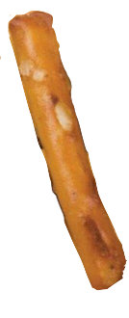
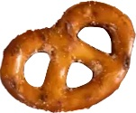
Shoppers generally like both pretzel pieces, they just want less of each.
SPECIFIC GARDETTO’S SNACK MIX PIECE PERCEPTIONS
The Pretzel pieces do not meet the goal JAR range for quantity. Only the Stick Pretzels contained in Test 2 meet the desired 70% mark. While Test 2 micro mini is significantly closer than Control and Test 1 to falling within the acceptable JAR range, the number of pretzels still fails to fall in the acceptable range.
B3B
LIKING
T3B
MEAN
Not enough | JUST ABOUT RIGHT | Too many
8% | 67% | 25%
10% | 63% | 27%
10% | 70% A | 20%
7% | 55% | 38%
9% | 54% | 37%
7% | 65% AB | 28%
52% | 31% | 17%
50% | 35% | 15%
47% | 38% | 15%
STICK PRETZEL
Control
7.60
7.62
7.65
7.51
7.49
7.63
8.10
8.17
9.00
Test 1
Test 2
PRETZEL
Control
Test 1
Test 2
Meets 70% JAR
Does not meet 70% JAR but Net Direction for Change <20%
Does not meet 70% JAR and Net Direction for Change 20%+
A
Control - 425
n = 220
B
Test 1 - 920
n = 219
C
Test 2 - 163
n = 220
Q: How much do you like or dislike the Stick Pretzel // Pretzel // Rye Chip piece in this Gardetto’s Snack Mix?
Q: The amount of Stick Pretzel // Pretzel // Rye Chip pieces in this Gardetto’s Snack Mix is…

Slide 12
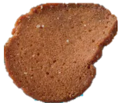
Shoppers love the Rye Chip, but want more of it in the mix.
B3B
LIKING
T3B
MEAN
Not enough | JUST ABOUT RIGHT | Too many
8% | 67% | 25%
10% | 63% | 27%
10% | 70% A | 20%
7% | 55% | 38%
9% | 54% | 37%
7% | 65% AB | 28%
52% | 31% | 17%
50% | 35% | 15%
47% | 38% | 15%
7.60
7.62
7.65
7.51
7.49
7.63
8.10
8.17
9.00
SPECIFIC GARDETTO’S SNACK MIX PIECE PERCEPTIONS
Rye Chip does not meet the JAR threshold, with nearly 50% of consumers wanting more Rye Chips in the mix.
RYE CHIP
Control
Test 1
Test 2
Meets 70% JAR
Does not meet 70% JAR but Net Direction for Change <20%
Does not meet 70% JAR and Net Direction for Change 20%+
A
Control - 425
n = 220
B
Test 1 - 920
n = 219
C
Test 2 - 163
n = 220
Q: How much do you like or dislike the Stick Pretzel // Pretzel // Rye Chip piece in this Gardetto’s Snack Mix?
Q: The amount of Stick Pretzel // Pretzel // Rye Chip pieces in this Gardetto’s Snack Mix is…

Slide 13
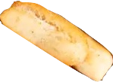
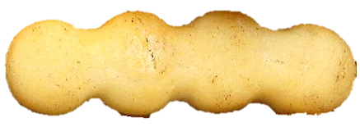
The Breadstick and Bread Squiggle are divisive in terms of the optimal amount.
SPECIFIC GARDETTO’S SNACK MIX PIECE PERCEPTIONS CONT’D
Only the Bread Squiggles contained in Test 2 meet the goal JAR range for quantity. Shoppers are split between wanting more and wanting less of each of these pieces.
Not enough | JUST ABOUT RIGHT | Too many
15% | 69% | 16%
18% | 63% | 19%
17% | 66% | 17%
18% | 69% | 13%
13% | 69% | 18%
14% | 70% | 16%
B3B
LIKING
T3B
MEAN
BREADSTICK
Control
7.95
7.84
7.89
7.70
7.73
7.78
Test 1
Test 2
BREAD SQUIGGLE
Control
Test 1
Test 2
Meets 70% JAR
Does not meet 70% JAR but Net Direction for Change <20%
Does not meet 70% JAR and Net Direction for Change 20%+
A
Control - 425
n = 220
B
Test 1 - 920
n = 219
C
Test 2 - 163
n = 220
Q: How much do you like or dislike the Breadstick // Bread Squiggle piece in this Gardetto’s Snack Mix?
Q: The amount of Breadstick // Bread Squiggle pieces in this Gardetto’s Snack Mix is…

Slide 14

Rye Chips are the most liked piece in the mix by 65-70% of consumers.
GARDETTO’S SNACK MIX PIECE RANKING | FAVORITE
Considering Rye Chips are by far the most preferred piece, it’s no surprise that consumers want more regardless of whether they tried the Control, Test 1 or Test 2 mix. The Pretzel garners fewer votes for favorite piece and falls toward to the middle of the preference ranking.
FAVORITE PIECE
Rye Chip
Rye Chip
Rye Chip
65% rank the Rye Chip
as their favorite piece
70% rank the Rye Chip
as their favorite piece
66% rank the Rye Chip
as their favorite piece
2
Breadstick| 13% rank as #1
2
Breadstick | 11% rank as #1
2
Breadstick| 11% rank as #1
3
Pretzel| 11% rank as #1
3
Pretzel| 9% rank as #1
3
Pretzel| 11% rank as #1
4
Bread Squiggle| 9% rank as #1
4
Bread Squiggle| 7% rank as #1
4
Bread Squiggle| 7% rank as #1
5
Stick Pretzel| 3% rank as #1
5
Stick Pretzel | 3% rank as #1
5
Stick Pretzel | 5% rank as #1
A
Control - 425
n = 220
B
Test 1 - 920
n = 219
C
Test 2 - 163
n = 220
Q: Please rank each piece of the Gardetto’s Snack Mix from your most to least favorite. (1 = most favorite, 5 = least favorite)

Slide 15

Regardless of product, the Pretzel is the least-liked piece overall.
GARDETTO’S SNACK MIX PIECE RANKING | LEAST FAVORITE
The stick pretzel, while neither alienating nor exciting in Control, was more likely to be ranked as a least favorite piece in Test 1 and Test 2.
LEAST FAVORITE PIECE
Pretzel
Pretzel
Pretzel
31% rank the Pretzel
as their least favorite piece
30% rank the Pretzel
as their least favorite piece
29% rank the Pretzel
as their least favorite piece
2
Bread Squiggle| 19% rank as #5
2
Stick Pretzel| 24% A rank as #5
2
Stick Pretzel| 25% A rank as #5
3
Rye Chip| 19% rank as #5
3
Bread Squiggle | 18% rank as #5
3
Bread Squiggle| 18% rank as #5
4
Stick Pretzel| 18% rank as #5
4
Rye Chip| 15% rank as #5
4
Breadstick| 15% rank as #5
5
Breadstick| 13% rank as #5
5
Breadstick| 11% rank as #5
5
Rye Chip| 14% rank as #5
A
Control - 425
n = 220
B
Test 1 - 920
n = 219
C
Test 2 - 163
n = 220
Q: Please rank each piece of the Gardetto’s Snack Mix from your most to least favorite. (1 = most favorite, 5 = least favorite]

Slide 16
Texture and flavor influence perceptions of each piece.
REASONS FOR GARDETTO’S SNACK MIX PIECE RANKING | CONTROL
Respondents’ favorite pieces are those that have crunchy or crispy texture, whereas the least liked pieces are considered flavorless and dry. The variability in texture and density tend to garner favorable rankings for the Rye Chip and Breadstick. However, too much hardness in the Rye Chips can be a deterrent for some.
REASON FOR FAVORITE
Control - 425
REASON FOR LEAST FAVORITE
Control - 425
“I love how crunchy the rye chip is as well as the flavor.”
“The taste. Great crunch and taste and texture is wonderful.”
“It is a classic flavor that I'm used to and remember from when I was a kid.”
“The crispness & taste!”
“It's a pretzel. Feels like a filler piece.”
“It doesn’t have much flavor. Leaves my mouth dry after eating it.”
PRETZEL
“It’s similar to the stick.”
“Way too many of them. They taste good, they're crunchy, just too many.”
“The bread squiggle is bland and has a weird texture.”
RYE CHIP
“It is full of flavor and amazing texture.”
“I like that the flavor and texture and that they are very crunchy.”
“They hold the flavor the best & they add a nice extra crunch to the mix.”
BREAD SQUIGGLE
“Kind of plain. Not much taste to them.”
“Super hard and way too thick of chips.”
“I don't like the taste of the rye chips and feel there are too many in the snack mix.”
“It has a slight bitter taste.”
“The rye chip is extra crunchy and more flavorful than the other pieces.”
“The texture and amount of crunch it has.”
RYE CHIP
BREADSTICK
“I’m not sure how much it adds since there’s already another pretzel type.”
“I like the lightness. The breadstick holds the most flavor.”
“I enjoy the seasoning mixed with the flavor and taste.”
PRETZEL
STICK PRETZEL
“I love pretzels as is and this pretzel is not too salty.”
“Doesn't hold onto flavor.”
BREAD SQUIGGLE
“The fun shape. I reach for these pieces first.”
BREADSTICK
“Not very flavorful.”
STICK PRETZEL
“I'm just a big fan of pretzels and the ones in the bag had great flavor.”
“I thought it had the least amount of flavor.”
n = 220
Q: What about the [insert piece selected as most favorite] piece makes it your favorite? Open-ended response
Q: What about the [insert piece selected as least favorite] piece makes it your least favorite? Open-ended response

Slide 17
The quantity of each piece influence perceptions…
REASONS FOR GARDETTO’S SNACK MIX PIECE RANKING | TEST 1
The Pretzel and Stick Pretzel struggle with dryness and blandness and are seen as duplicative outside of their shape difference.
REASON FOR FAVORITE
Test - 920
REASON FOR LEAST FAVORITE
Test - 920
“The flavor and crispness is really good.”
“It's crunchy and has more flavor. It's not as dry as the other items.”
“The flavor and crunch is awesome. It packs the most flavor out of all the pieces.”
“Tastes the best and has the best crunch.”
“Can be bland when eaten separately.”
“Just way too many of them.”
“They are too dry.”
PRETZEL
“There were too many pretzels.”
“It's bland. Hard to taste the flavor once you chew it up a bit.”
“I just find stick pretzels boring”
RYE CHIP
“Crunchy and garlic taste.”
“It just seems to soak up the most flavors.”
“The crunch, salty, has the most flavor.”
“The concentrated flavor.”
STICK PRETZEL
“It's another pretzel, and it's kind of boring”
“It’s boring. One pretzel piece is enough.”
“Doesn't seem to hold as much flavor.”
“I love the texture and flavor. Plus I like that it is bigger.”
“Flavor is great. Wasn’t too hard like some rye chips.”
“The split in the middle that holds flavor.”
BREAD SQUIGGLE
“It doesn’t have as much of the seasoning flavor”
“It’s almost the same as the regular breadstick”
BREADSTICK
“Easy to chew and very tasty.”
“Flavor, size, crunch…good quality pretzel”
“A little larger than ideal.”
“Don’t like the flavor or stale bread.”
RYE CHIP
PRETZEL
“Easy to pick up and love the flavored seasoning.”
BREAD SQUIGGLE
“Least flavorful.”
“Light and crunchy. Easy for little fingers to grab.”
BREADSTICK
“It's more bland tasting than the other pieces.”
STICK PRETZEL
“The shape and texture.”
n = 219
Q: What about the [insert piece selected as most favorite] piece makes it your favorite? Open-ended response
Q: What about the [insert piece selected as least favorite] piece makes it your least favorite? Open-ended response

Slide 18
…and reinforce the importance of piece variety in the mix.
REASONS FOR GARDETTO’S SNACK MIX PIECE RANKING | TEST 2
While both pretzel pieces are bite-sized and easy to eat, they don’t generate excitement, and lack differentiation.
REASON FOR FAVORITE
Test - 163
REASON FOR LEAST FAVORITE
Test - 163
“it is a different taste than what you normally get from a snack mix.”
“I love the crunch! It's just so satisfying and tasty.”
“I think they hold the most flavor and they are just so delicious.”
“It has the most flavor. It really holds onto the seasoning.”
“Didn’t seem to hold as much of the flavor.”
“Too many pretzels with both types there.”
“Little too dry, doesn't have as much flavor.”
PRETZEL
“It loses flavor the quickest. During chewing it doesn't taste like much.”
“Too pokey.”
RYE CHIP
“The flavor and it is a unique component.”
“It’s large and tastes great. It is a very satisfying snack.”
“I love the flavor of it and the crispness.”
“It's tasty and crunchy with deep rye taste.”
STICK PRETZEL
“It’s just kind of bland.”
“There is already another pretzel in the mix, so too much of the same thing.”
“They often don’t have much seasoning on it”
“They are just delicious and seem to have the most flavor.”
“They have a flavor to them that my mouth really enjoys!”
"I love the softer crunch that this piece has.”
“A little more bland. Squiggle and other bread stick are redundant.”
“It doesn’t have as much flavor as the rye chips.”
BREAD SQUIGGLE
BREADSTICK
“I like the salty flavor, buttery kind of.”
“Good size bite and has a great flavor.”
BREADSTICK
“It's a little boring and too soft.”
“It can be too dry.”
PRETZEL
“The texture and how it collects the flavor.”
BREAD SQUIGGLE
“Not my favorite flavor very large sometimes hard texture, too big”
“The shape of this piece is so fun and interesting.”
RYE CHIP
STICK PRETZEL
“I love pretzels. I can grab a couple and not feel guilty.”
“Too hard and crunchy.”
n = 220
Q: What about the [insert piece selected as most favorite] piece makes it your favorite? Open-ended response
Q: What about the [insert piece selected as least favorite] piece makes it your least favorite? Open-ended response

Slide 19
Appendix

Slide 20
Alienation is mitigated as both test products are likeable and exceed expectations.
KEY MEASURES
 | Control [Code 425] | Test 1 [Code 920] | Test 2 [Code 163]
 | A | B | C
Base | 220 | 219 | 220
Purchase Intent
Top Box (Very likely) | 88% | 84% | 86%
Top 2 Box (Very + Somewhat likely) | 98% | 98% | 97%
Alienation (Pre-to-Post B2B) | 0% | 0% | 1%
Overall Liking
Top Box (Like extremely) | 54% | 53% | 56%
Top 2 Box (Like extremely + very much) | 96% | 94% | 95%
Top 3 Box (Like extremely + very much + moderately) | 99% | 99% | 99%
Mean (9-pt scale) | 8.48 | 8.45 | 8.45
Expectations
Top Box (Much better than I expected) | 27% | 36% A | 35% A
Top 2 Box (Much + Somewhat better than I expected) | 49% | 55% | 56%
Top 3 Box (Much + Somewhat + About what I expected) | 100% | 98% | 98%
Bottom 2 Box (Much + Somewhat worse than I expected) | 0% | 2% | 2%
Uppercase letters (A B | C D | A C | B D ) represent sig. at the 90% confidence interval.
Lowercase letters (a b | c d | a c | b d ) represent sig. at the 70% confidence interval.
Notes:
Stat testing at 70%

Slide 21
Most recalled purchasing Gardetto’s within the past month.
LAST PURCHASE
LAST PURCHASE
Past Month or More Recent:
77% | 67% | 59%
A
Control - 425
n = 220
B
Test 1 - 920
n = 219
C
Test 2 - 163
n = 220
Q: When was the last time you purchased this Gardetto’s Snack Mix for your household?

Slide 22


Participant Demographics
GENDER
HH INCOME
RACE/ETHNICITY
94%
6%
AGE
MARITAL STATUS
Average Age: 42
REGION
Total Buyers n = 659

Slide 23
Thank you!
Eliza Hammond
Lead Consumer Research Analyst
eliza.hammond@ibotta.com
Sogol Shirazi
Senior Consumer Research Analyst
sogol.shirazi@ibotta.com
Leslie Na
Senior Director, Business Development
leslie.na@ibotta.com
© 2023 Ibotta, Inc.

